Slide 1
Haptic Fitness CSED404 Proposal Presentation
Team TCPs / Member Chan-ki Hwang & Taeyeon Kim

Slide 2
Why we chose fitness?

Slide 3
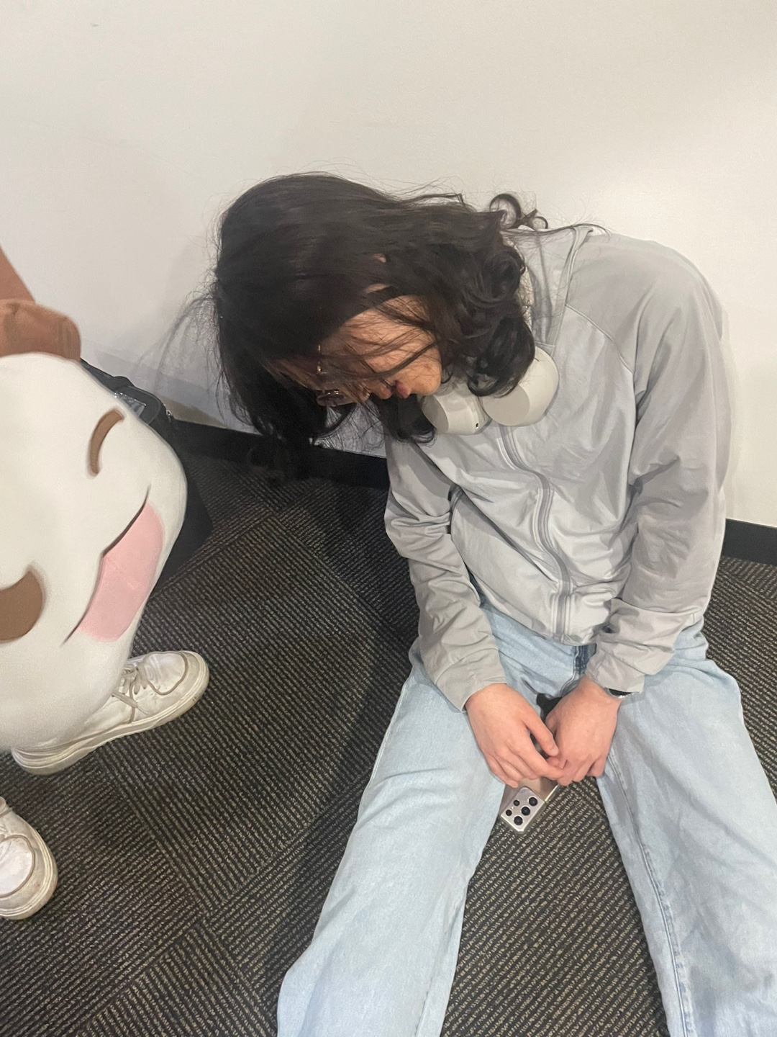
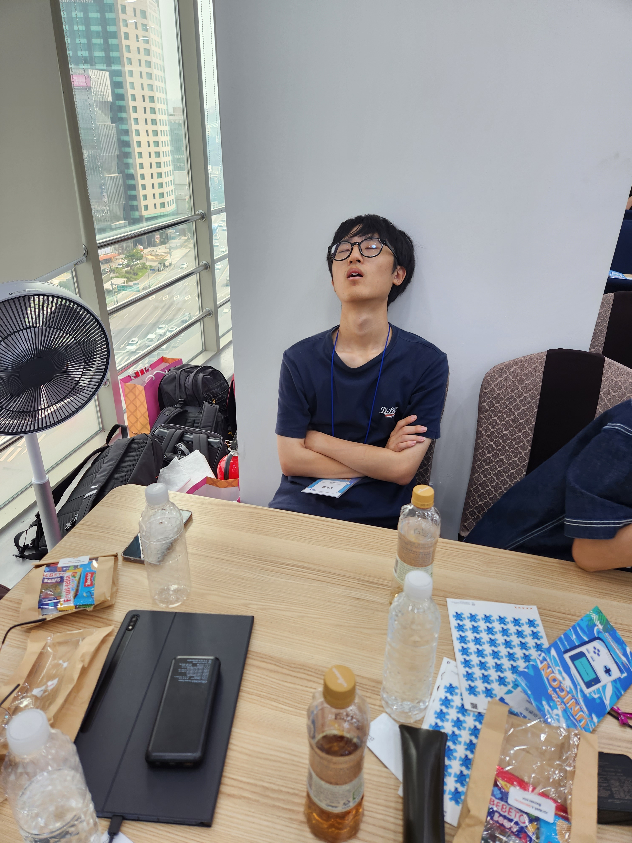
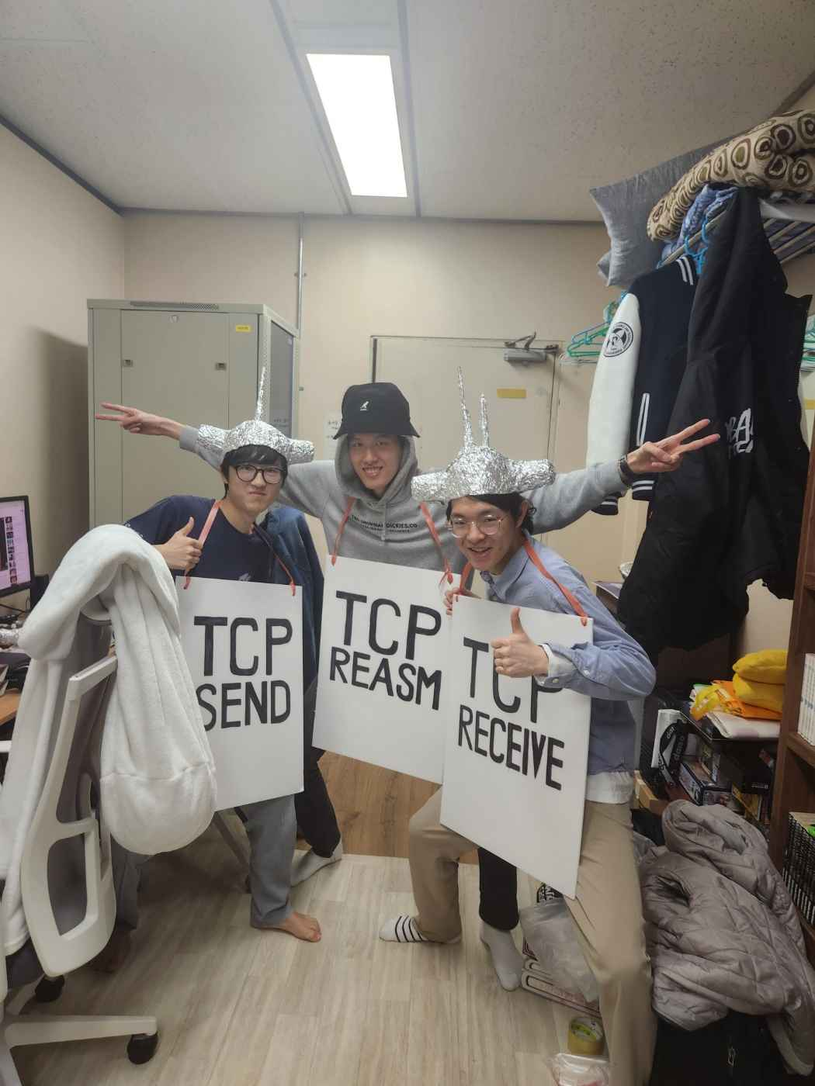
Why we chose fitness?
These guys ABSOLUTELY seem to need exercises. Don’t they?

Slide 4
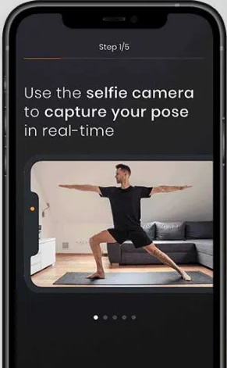
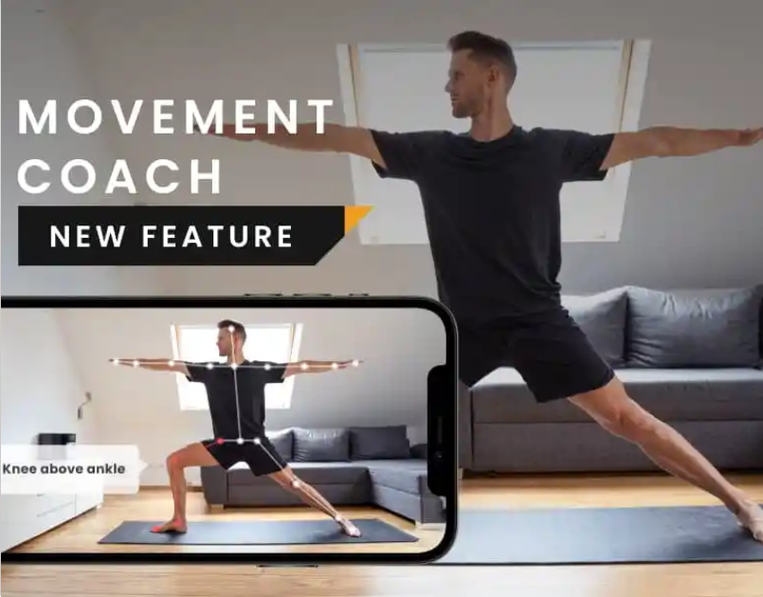
Current Solution
Visual information & Visual feedback

Slide 5


Feedback to user’s action
Visual Feedback
Capture the pose
Display better pose

Slide 6
Feedback to user’s action
Visual Feedback
Capture the pose
???
Mobile devices are too small!
Display better pose

Slide 7
Feedback to user’s action
Vocal Feedback
Capture the pose
Bent knee more!
Tell better pose

Slide 8


Feedback to user’s action
Vocal Feedback
Capture the pose
???
Delay between feedback!
Bent knee!
Strech arm!
Extend back!
Strech arm!
Bent knee!
Tell better pose

Slide 9


Feedback to user’s action
Real-time
Immediate response is required
No delay between feedback action
Directive
Reasonable feedback is required
Feedback must be easy to understand
Should available even device can’t put apart

Slide 10
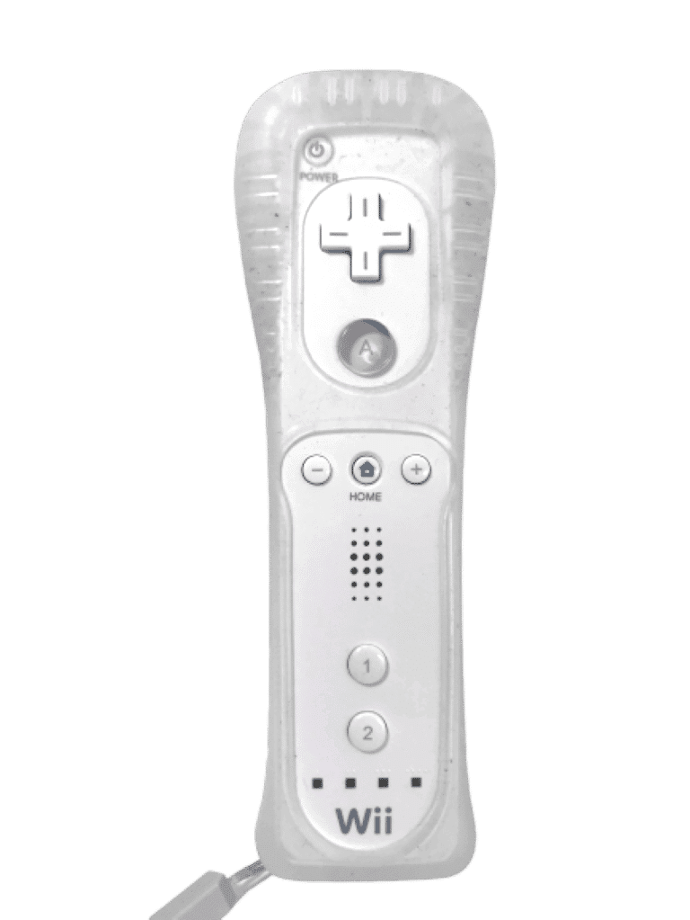

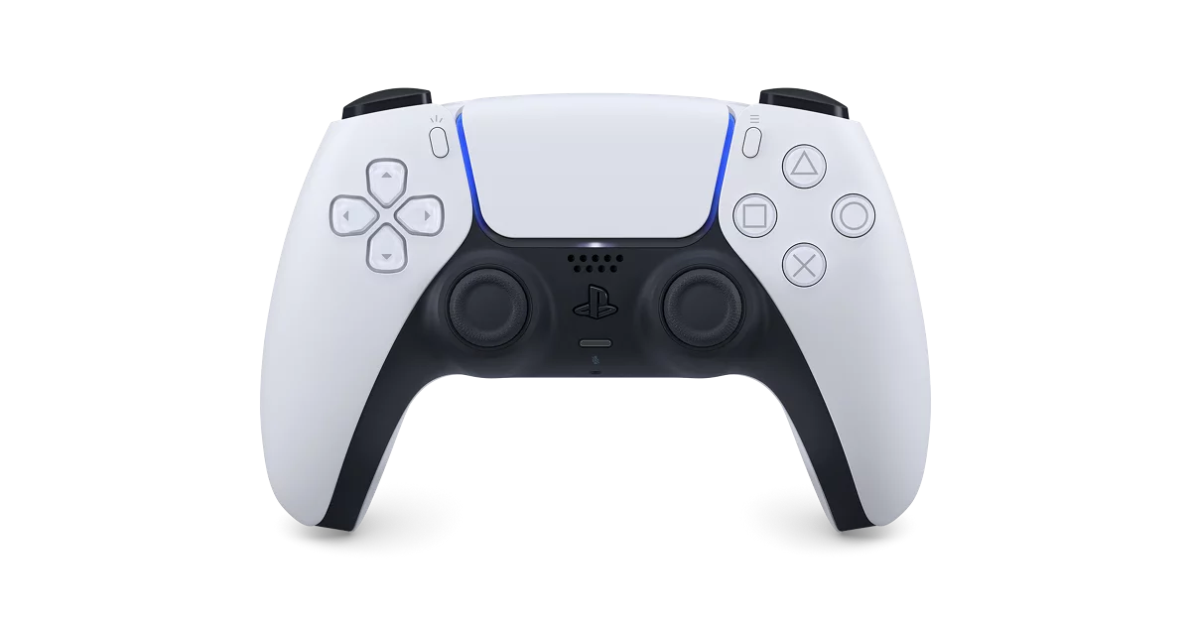
Feedback to user’s action
Haptics

Slide 11


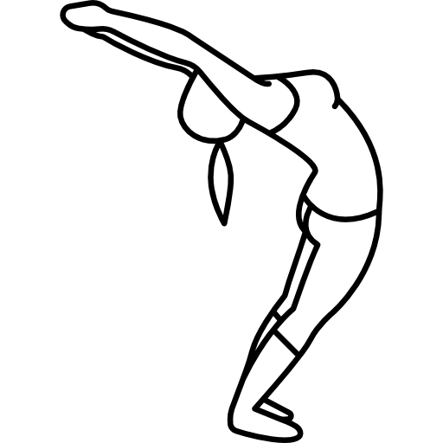
Gathering user action data
Hold the device
perpendicular or parallel
to main axis

Slide 12
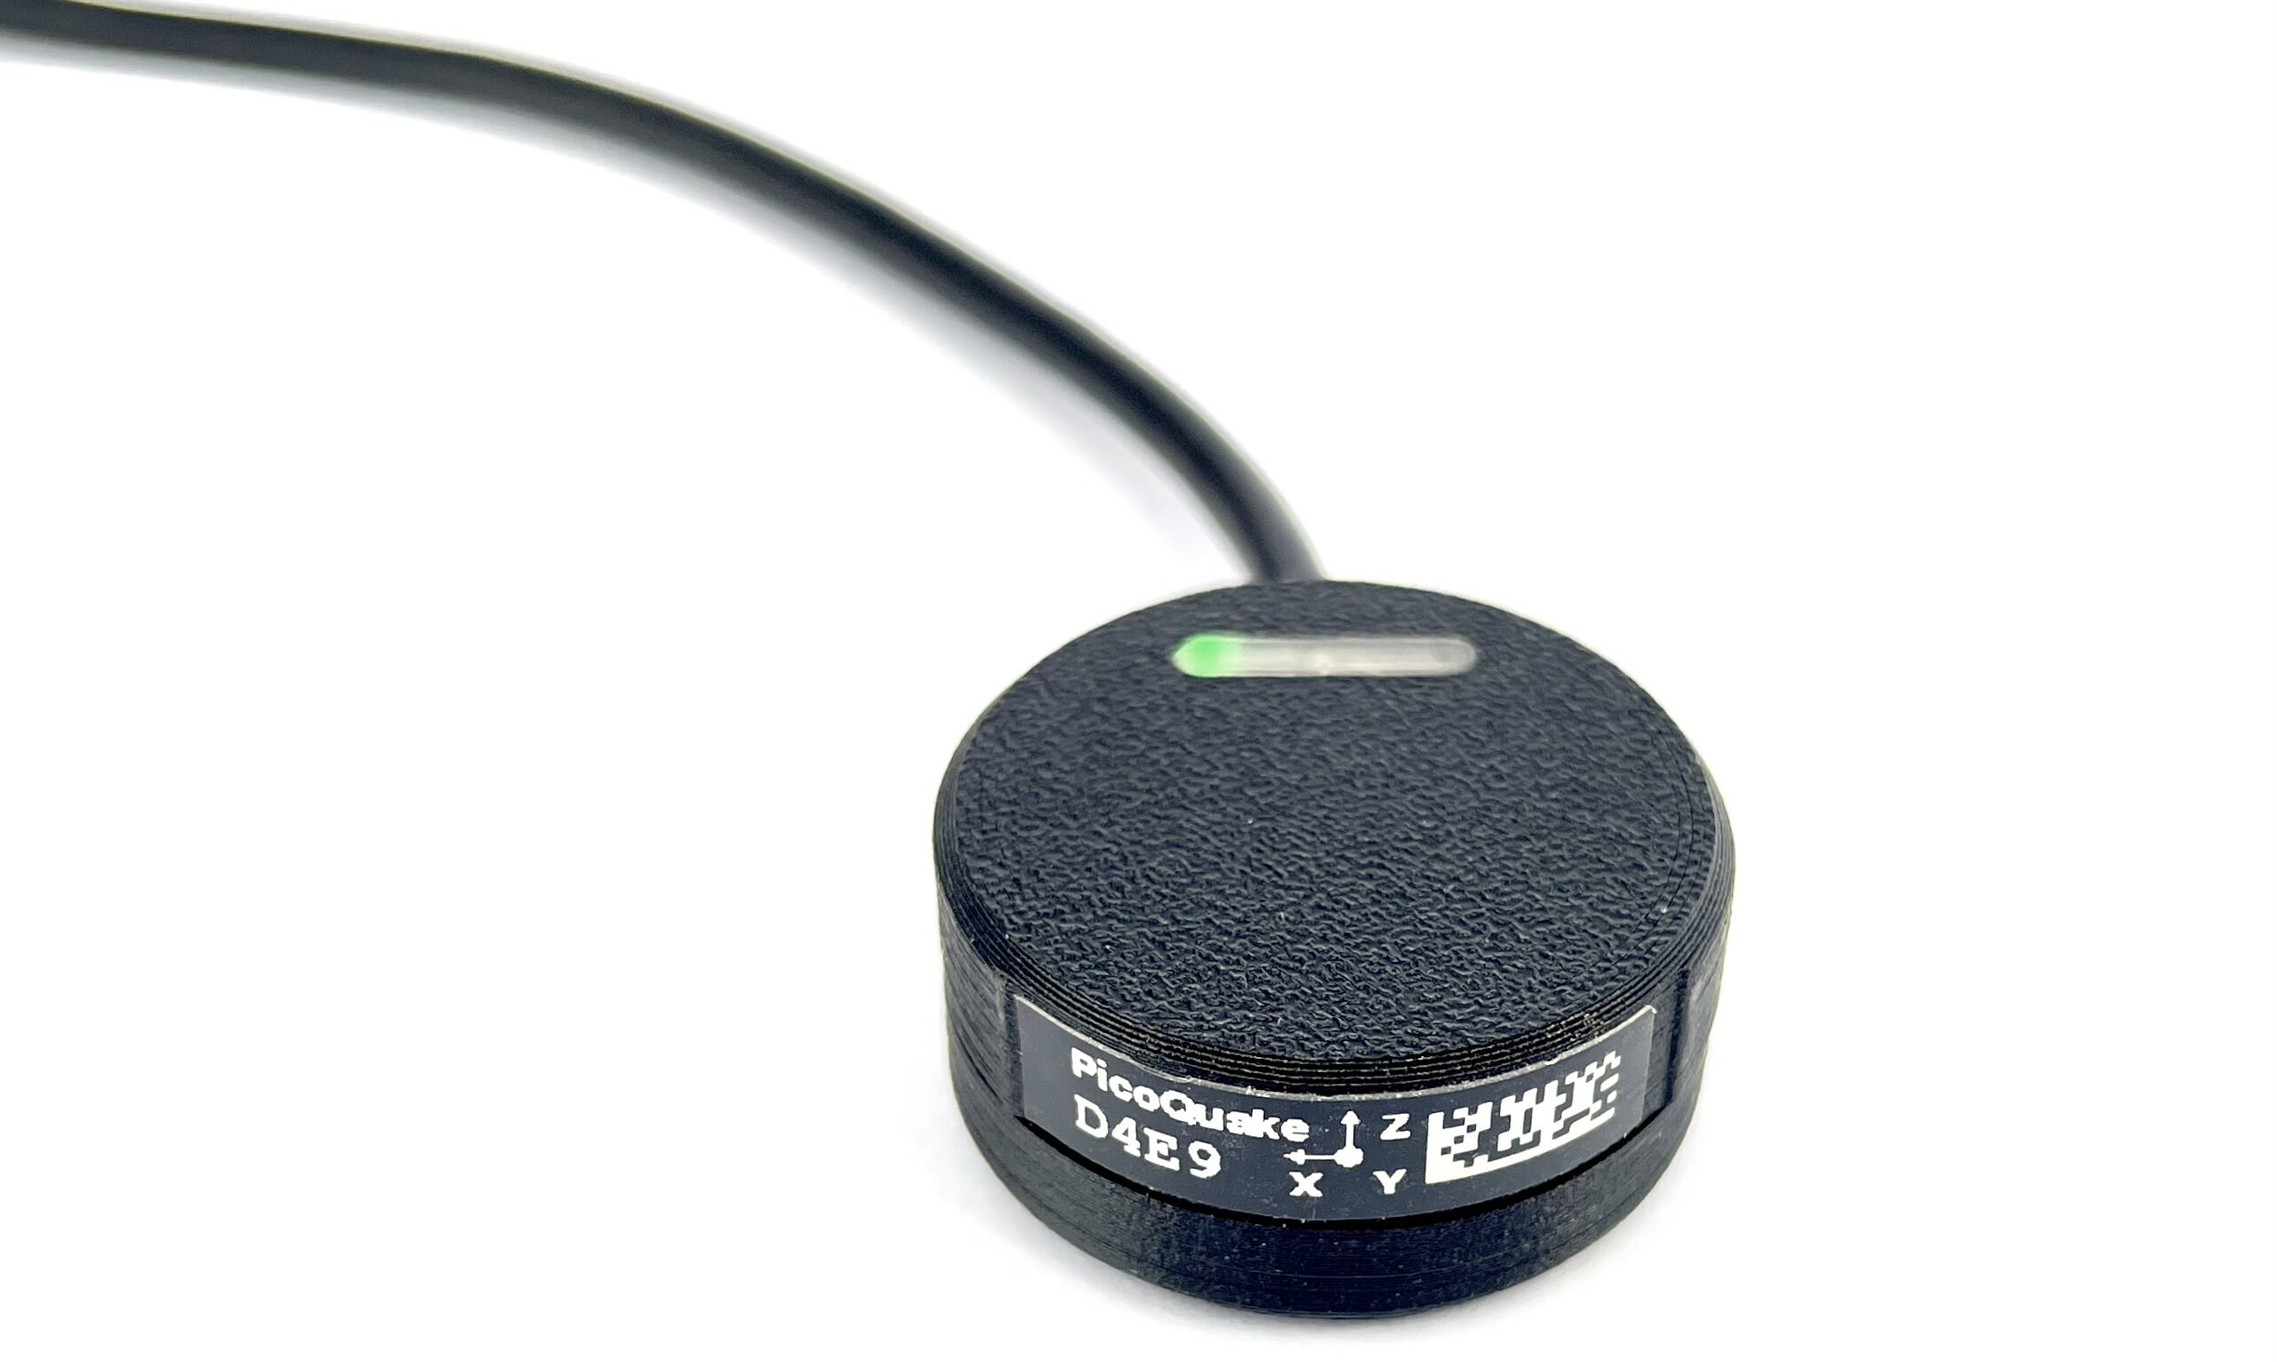
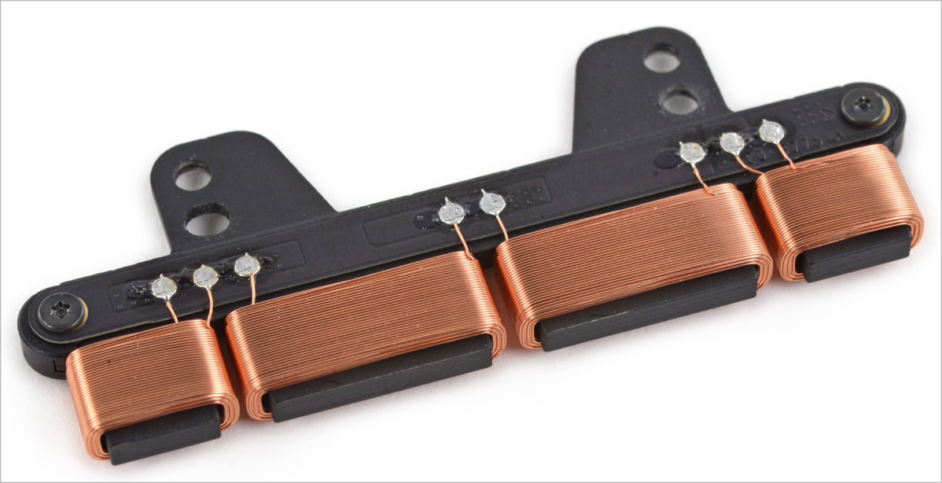
Haptic feedback to user’s action
Vibration Motor
Haptic Device
Haptics
Intensity Controlable
NOT clear
Intensity & Pattern Controlable
Clear vibration!

Slide 13
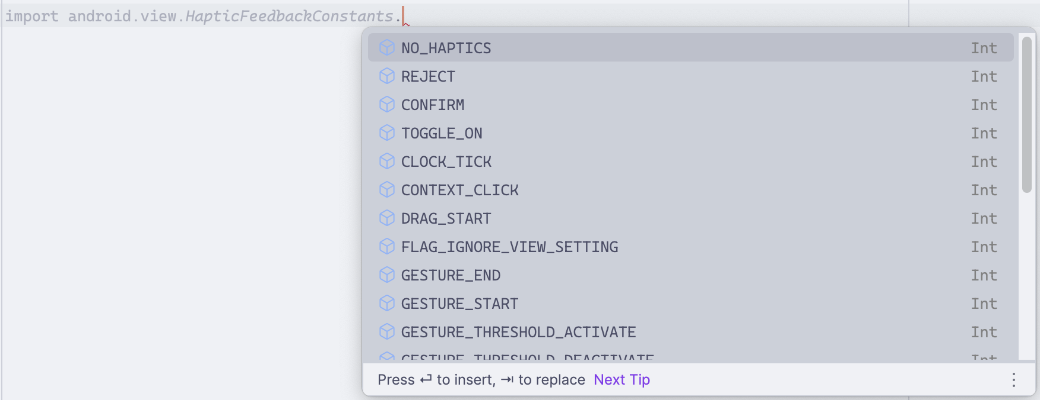
Haptic feedback to user’s action
Haptics
Pre-“designed” Haptic Patterns
- Available at android.view.HapticFeedbackConstants

Slide 14
Haptic feedback to user’s action
Real-time
No delay between vibratory feedbacks
Directive
Various haptic patterns provided by system
Dynamic feedback on specific event, interval…
Attach on the body to fetch user’s position

Slide 15

Example – Squat
v
Start/Stop Exercise
Feedback on Event
Reach to specific angle
Entering/Leaving “SAFE” zone
CONTEXT_CLICK
“HIGH”
TOGGLE_OFF
TOGGLE_ON
Feedback on Interval
Keep vibrate in “SAFE” zone
“SAFE”
TOGGLE_ON
“LOW”
TOGGLE_OFF

Slide 16

Example – Back Stretch
TOGGLE_ON
TOGGLE_OFF
REJECT
“MORE”
“SAFE”
Feedback on Event
Between “SAFE” & “MORE” zone
Start/Stop Exercise
REJECT
Dynamic Feedback on Interval
Stronger REJECT pattern as back goes deeper
“DANGER”

Slide 17

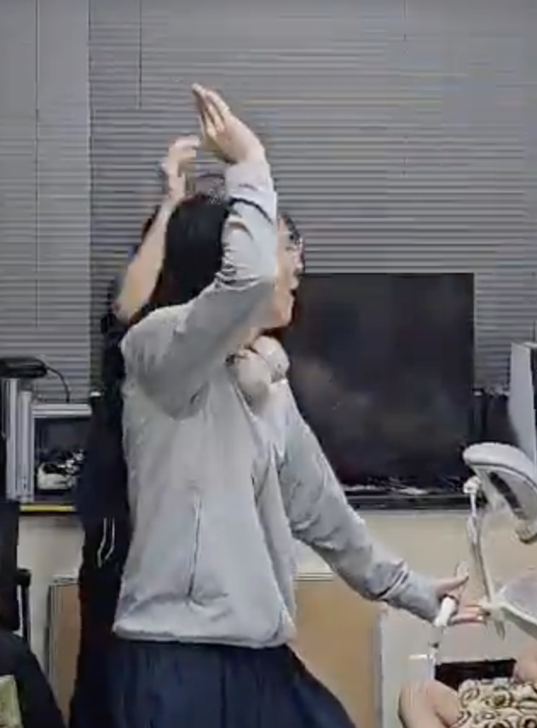

Expectations and Further usage?
APTIC

Slide 18
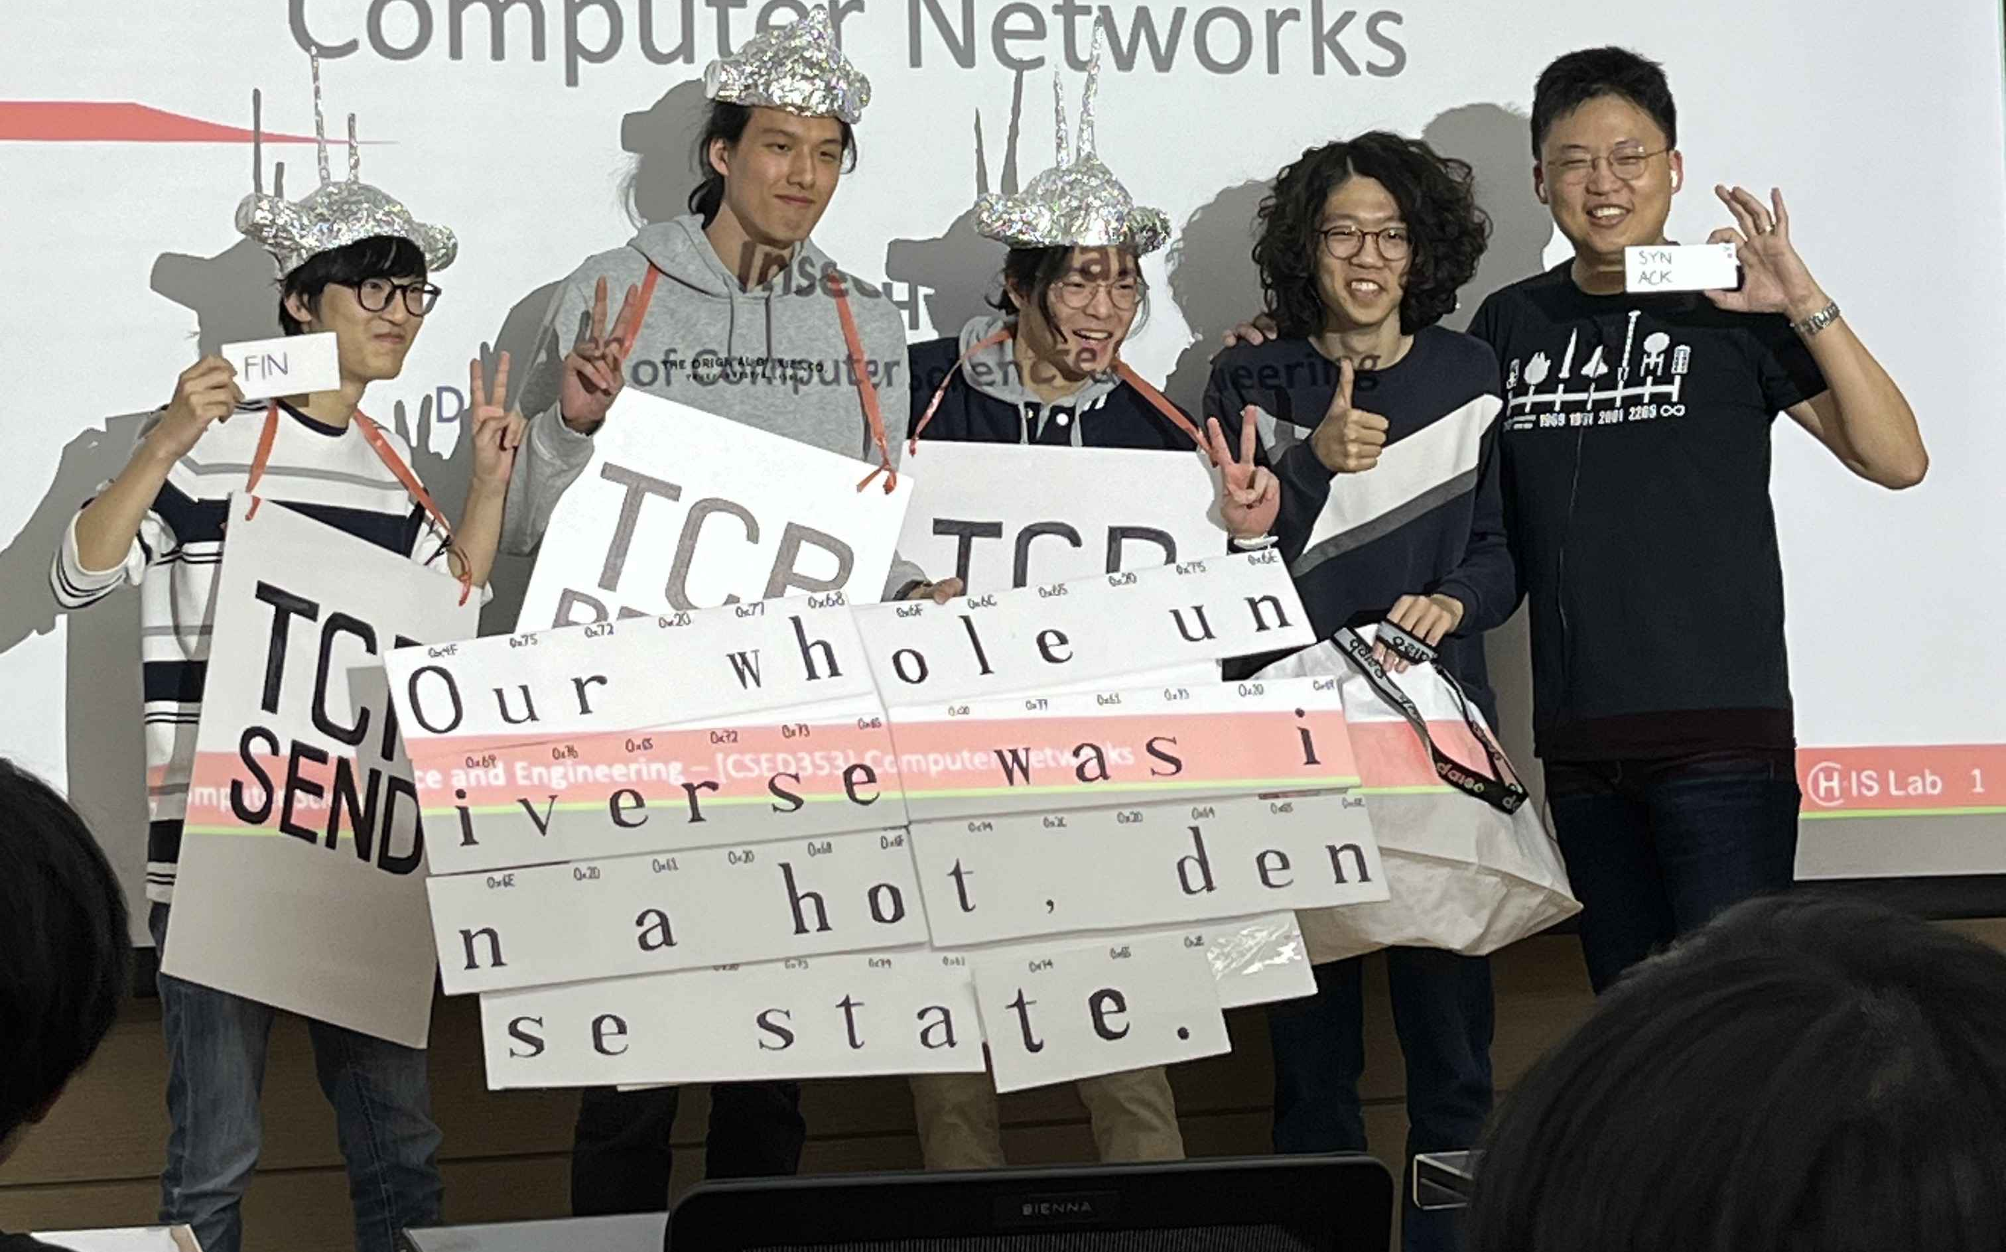
Thanks for Listening!

